Slide 1
Job Search

Slide 2
Profile
Career objectives
Summary of qualifications

Slide 3
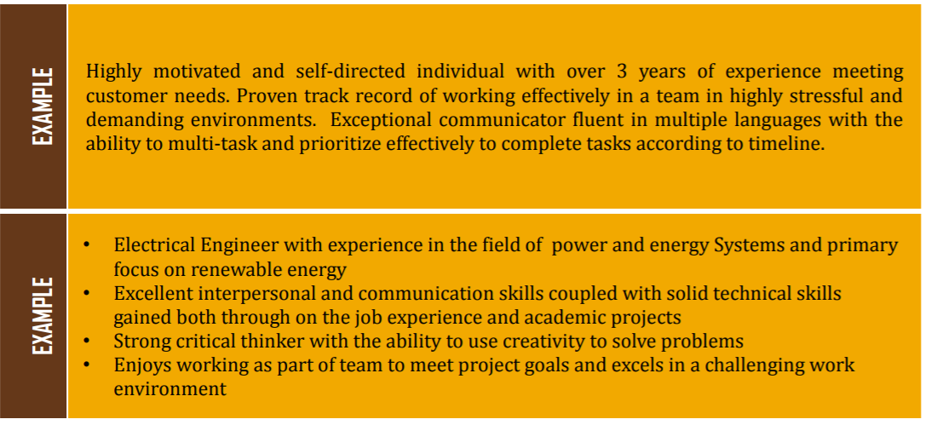
Profile: Sample

Slide 4
Common Errors
Personal pronouns
Narrative style
Long objective statement
Numbered or lettered categories
Acronyms / abbreviations
Slang / colloquialisms
Personal information
GPA/ Percentage/ Marks

Slide 5
Common Errors
Outdated language
References section
Duty listing
Fancy fonts
Unprofessional email address
Routine job duties
‘Busy’
Spelling, grammar or language errors

Slide 6
Electronic Resumes
Use plain text; no highlighting techniques, line breaks, or visual aids
Use simple font styles
List phone number on its own line
Repeat keywords
Do not copy/paste from the job ad
Say ‘work experience’

Slide 7
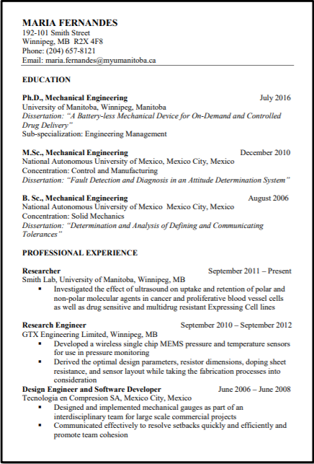
CV for industry

Slide 8
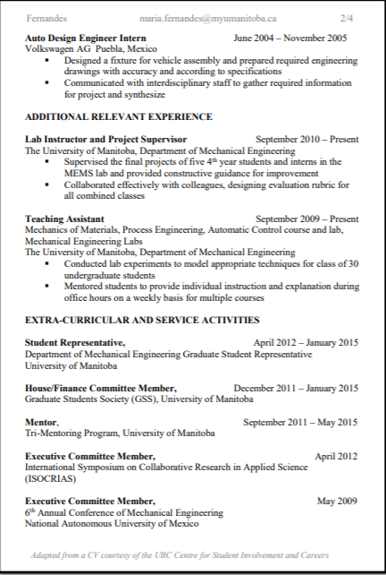
CV for industry

Slide 9
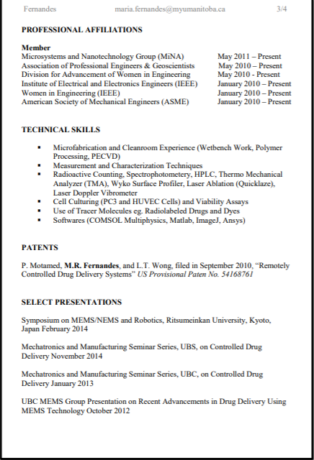
CV for industry

Slide 10
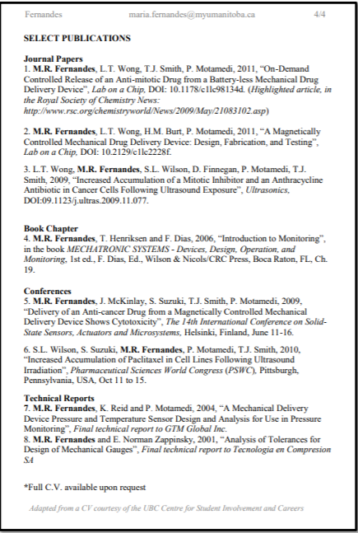
CV for industry

Slide 11
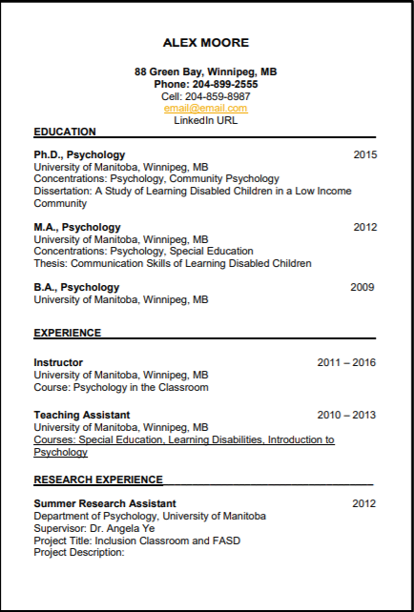
Standard CV

Slide 12
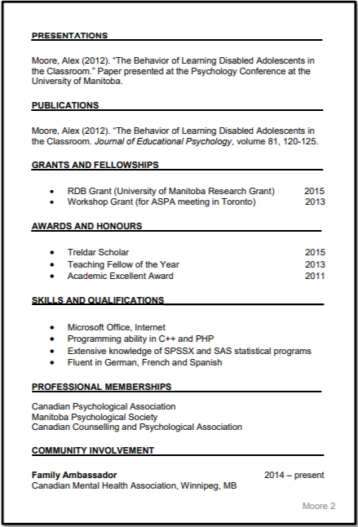
Standard CV

Slide 13
Job Application Letters
Application letter or cover letter complements your resume
Explain how your credentials fit the particular job and convey a likeable persona for the prospective employer.
Highlight specific qualifications

Slide 14
Abbey Kohut calls the application letter “a writing-skills evaluation in disguise”

Slide 15
Job Application Letter
https://www.youtube.com/watch?v=hrZSfMly_Ck [How to Write a Cover Letter 1:55 min]
https://www.youtube.com/watch?v=FCAlpMrUrsc [

Slide 16
Solicited Vs. Unsolicited Job Application Letters
Solicited Application letters
Message is expected
Name the job and where you saw it advertised
Unsolicited Application letters
Message is unexpected so more research us required
Grab the attention of reader by establishing a connection of an acquaintance or making a strong statement
Identify yourself and background
Spell out your case and relate qualifications to responsibilities. Conclusion restates interest and emphasizes willingness.
Address the hiring manager and consult websites for the details

Slide 17
Guidelines for Job Application Letter
If you can’t find a name, addressing your letter to “Dear Hiring Manager” is perfectly acceptable.
Clearly identify the opportunity you are applying for or expressing interest in.
Show that you understand the company and its marketplace.

Slide 18
Guidelines for Job Application Letter
Develop an excellent prototype letter
Show some personality while maintaining a business-appropriate tone.
Customize each letter for the specific job opening.

Slide 19
Guidelines for Job Application Letter
Create a dynamic tone with active voice and action verbs. Be confident without seeming arrogant.
Never be vague and never exaggerate. Avoid flattery.
Be concise

Slide 20
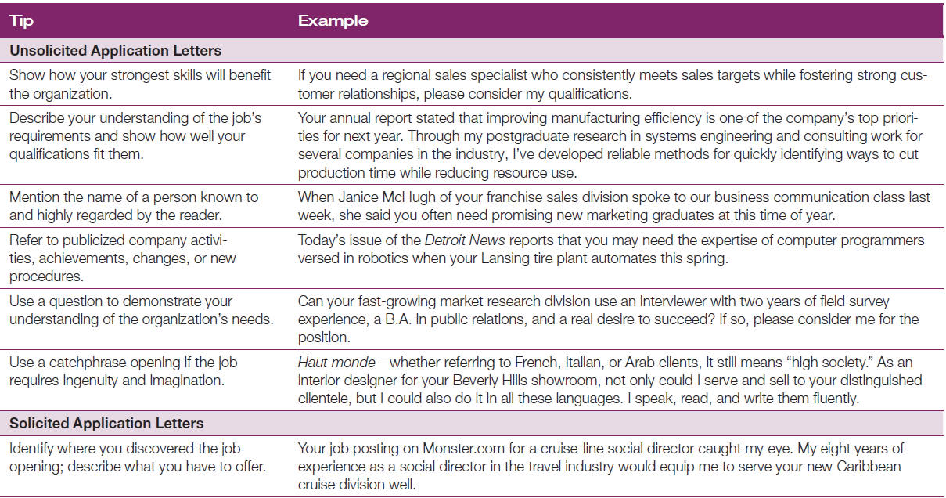

Slide 21
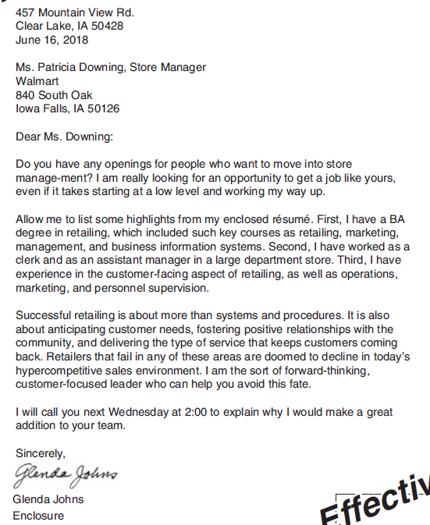
Unsolicited Job Application Letters

Slide 22
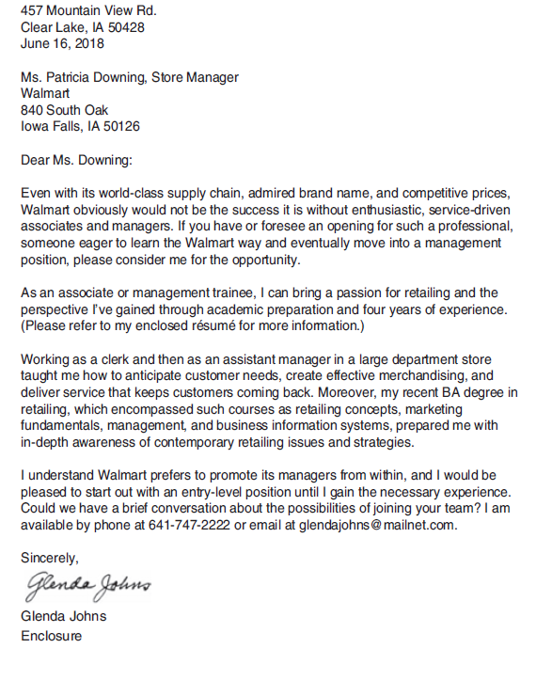
Unsolicited Job Application Letters

Slide 23
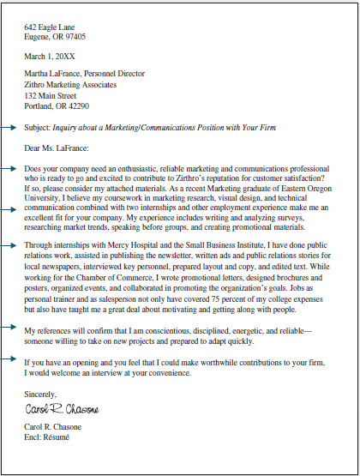
Unsolicited Job Application Letters

Slide 24
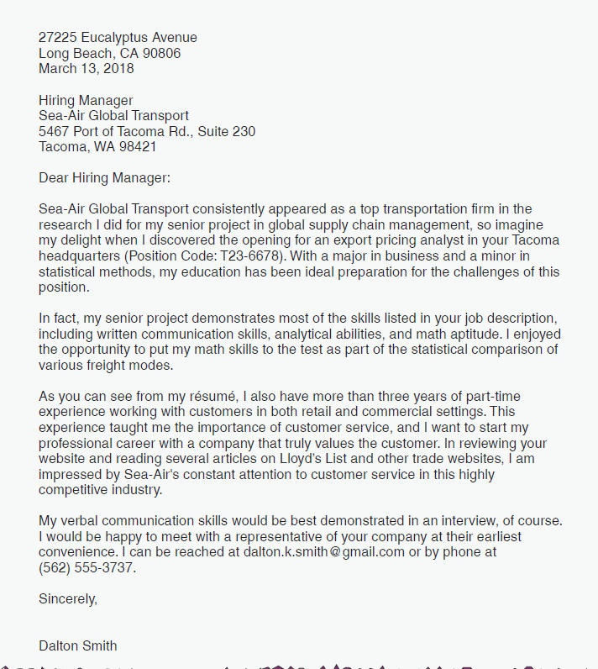
Solicited Job Application Letters

Slide 25
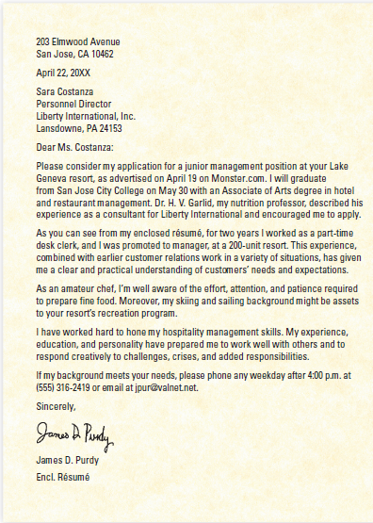
Solicited Job Application Letters

Slide 26

Interview
Allows in-depth exploration of ideas/phenomenon/concepts
Generally open-ended questions
Allows respondent to answer freely
Can be useful for exploration of new ideas, experiences, and/or perspectives and opinions

Slide 27
Interview: Stages
Screening Stage
Filter out applicants who are unqualified
Not a good fit for the position
Selection Stage
Top candidates out of those who qualified
Show keen interest related to the job
Final Stage
Hiring committee shares advantages of joining the organization
Sell your skills for the requirements of the job

Slide 28

Qualities of an Interviewer
Knowledgeable – Familiar with the topic
Structured – outline the procedure of the interview
Clear – Able to articulate clearly, & use simple words to formulate questions
Gentle – Tolerant, sensitive and patient
Steering – Controlling the course of the interview
Critical – Testing the reliability and validity of the information
Remembering – Retaining the information provided
Interpreting – Offering interpretation of what the interviewee says
Observant – Able to observe and interpret any nonverbal cues

Slide 29
Types of Interviews
Structured interviews
Unstructured interviews
Panel and Group Interviews

Slide 30
Types of Interviews
Series of questions in predetermined manner.
Help employers identify candidates who don’t meet basic job criteria
Allow team to compare answers from multiple candidates
Interviewer adapts his or her line of questioning
Keep answers focused and professional
Group or panel interviews
Group interviews:
You meet with several interviewers at once.
Panel interviews:
One or more interviewers meet with several candidates simultaneously.

Slide 31
Panel Vs. Group Interviews
Panel Interviews: Tips
Make connections with each person on the panel
Tailor your answers accordingly
Group Interviews: Tips
It is observed how the candidates interact
Be sure to treat your fellow candidates with respect while demonstrating your knowledge.

Slide 32
Types of Interviews
One-on-One
Time consuming; One person at a time
Focus Group
Groups of 4-6
Telephone
Limited number of questions
E-Mail
Asynchronous

Slide 33
Structured Interviews
Prepared set of questions
No room for digressions or additional questions
No room for digressions or additional questions
Fixed structure and timing

Slide 34
Unstructured Interviews
General theme in mind, but no pre-designed questions
Questions are designed on the spot, depending on the respondent’s responses
More time consuming
Allow room for exploration of new ideas/themes

Slide 35
Semi-Structured Interviews
Pre-designed questions, with room for modification
Room to add more questions if the need arises
Room to add details and clarify questions if the respondent(s) don’t understand

Slide 36
Selecting your Subjects
Focus your needs – What kind of people do you need?
Clearly highlight the demands of your study – Who would be the most appropriate and relevant?
Do not settle for the easy way – Decide objectively and unbiasedly who would be the most suitable for your requirements

Slide 37
Selecting your Subjects
Reach out to potential subjects – Follow the guidelines of technical communication
Do not assume everyone will respond positively – Always keep a backup; Reach out to more people than you need

Slide 38
Ethical Guidelines
Always ask for consent
Clearly communicate the purpose and objectives
Do not force participation
Lay out the procedural outline of your interview

Slide 39
Ethical Guidelines
Do not manipulate/modify the interview data
Accommodate the respondents; don’t expect them to accommodate you
Keep it confidential

Slide 40





Designing Interview Questions
Keep it simple
Keep it neutral
Ask questions that prompt long responses
Ask questions one at a time
Encourage responses during the interview

Slide 41
Types of Questions
1
Direct – “How do you feel about…”
2
Indirect – “How do most people feel about…”
3
Follow-up – “Could you say more about…”
4
Specifying – “What did you do then…”
5
Interpreting – “Do you mean that…”

Slide 42
Sources for Job Postings
www.twitjobsearch.com (look up jobs posted online)
www.indeed.com
www.rozee.pk

Slide 43
Additional Resources
https://youtu.be/BxPy_-cl4mY [Resume Words to Include and Avoid 1:34 min]
https://youtu.be/enD8mK9Zvwo [How to Prepare for a Job Interview 3 min]
https://youtu.be/Si4GLeQoqLA [How To Ace Your Job Interview Over Zoom | Forbes]
https://youtu.be/HG68Ymazo18 [Top Interview Tips: Common Questions, Body Language & More 5 min]

